Slide 1
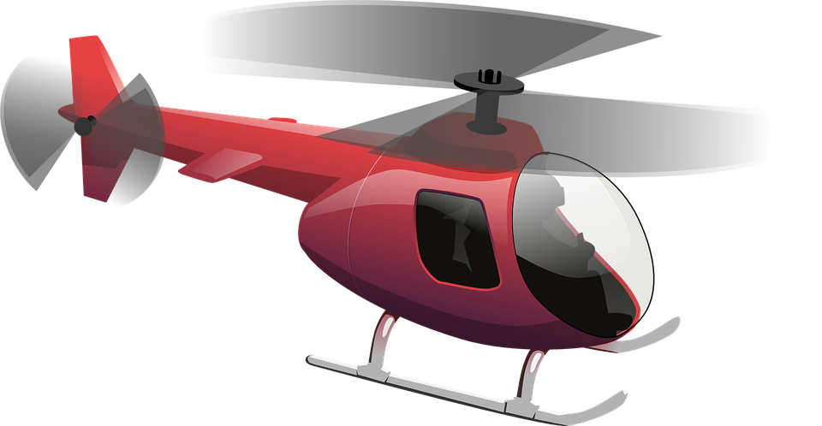
Walter and Ethel $50 is $50

Slide 2
$50 is still $50

Slide 3
if you can both stay quiet for the entire ride and not say a word I won’t charge you!

Slide 4
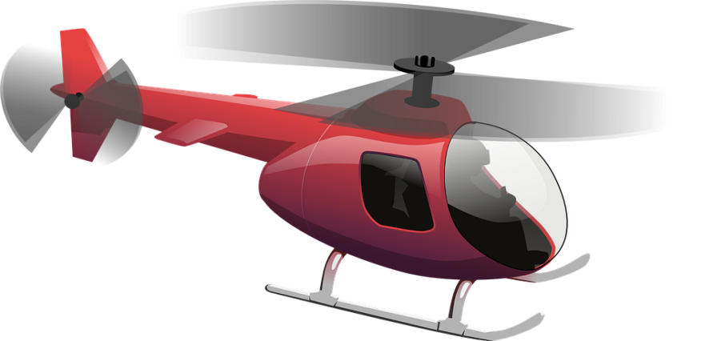

Slide 5
$50 is still $50

